Slide 1
Unit 2 – Boolean Algebra and Logic Gates

Slide 2
Boolean Algebra
Boolean algebra is algebra for the manipulation of objects that can take on only two values, typically true and false
A two-valued Boolean algebra is defined on a set of 2 elements B = {0, 1} with 3 binary operators OR (+), AND ( • ), and NOT ( ' )

Slide 3
Properties of Boolean Algebra
Commutative
Changing the sequence of the variables does not have any effect on the output of a logic circuit.
A • B = B • A
A + B = B + A
Associative
The order in which the logic operations are performed is irrelevant as their effect is the same
( A • B ) • C = A • ( B • C )
( A + B ) + C = A + ( B + C)

Slide 4
Properties of Boolean Algebra
Distributive
A • ( B + C) = (A • B) + (A • C)
A + (B • C) = (A + B) • ( A + C)
Neutral Element
0 + A = A
1 • A = A
Complement (Inverse)
A + A = 1
A • A = 0

Slide 5
Laws of Boolean Algebra
Idempotent Law
A • A = A
A + A = A
Identity Law
A + 1 = 1
A • 0 = 0
Absorption Law
X • (X + Y) = X
X + X • Y = X

Slide 6
Duality Principle
According to the duality principle
AND can be converted to OR => (.) sign with (+)
OR can be converted into AND => (+) sign with (.)
We can also interchange '0 with 1’ and '1 with 0’
The Duality principle states that when both sides are replaced by their duals the Boolean identity remains valid
Every algebraic expression deducible from the postulates of Boolean algebra remains valid if the operators and identity elements are interchanged

Slide 7
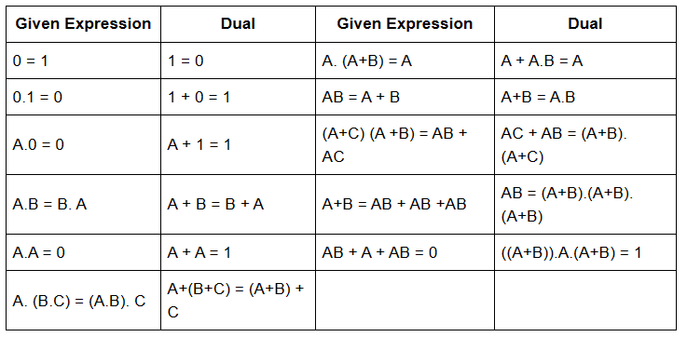
Duality Principle

Slide 8
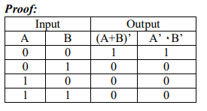
De-Morgan’s Theorem
De Morgan’s theorem is used to convert OR type of expression into AND type and vice-versa. It is further divided into two different types;
1st law:
It state that the total complement of sum is equal to the product of individual complement. i.e. (A+B)’=A’ ٠B’

Slide 9
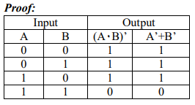
De-Morgan’s Theorem
2nd law:
It state that the total complement of the product is equal to the sum of individual complement. i.e. (A٠B)’ =A’+B’

Slide 10
Boolean Function
A binary variable can take a value of 0 or, 1
A Boolean function is an expression formed with binary variables, the two binary operators OR and AND, unary operator NOT, parenthesis and an equal sign
For a given value of variables, the function either can 0 or 1.
𝐹1 = 𝑥𝑦𝑧 ′
𝐹2 = 𝑥 + 𝑦′𝑧

Slide 11
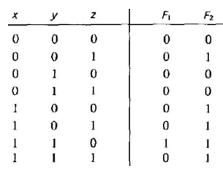
Boolean Function (contd.)
Truth Table of Boolean function
𝐹1 = 𝑥𝑦𝑧 ′
𝐹2 = 𝑥 + 𝑦′𝑧

Slide 12
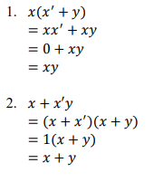
Algebraic Manipulation
When a Boolean function is implemented with logic gates, each literal in the function designates an input to a gate and each term is implemented with a gate
The minimization of the number of literals and the number of terms results is a circuit with less equipment.
Simplify the following Boolean functions to a minimum number of literals.

Slide 13
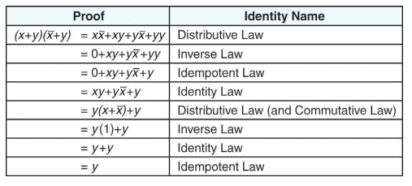
Algebraic Manipulation (contd.)
Prove that: (𝒙 + 𝒚)(𝒙̅ + 𝒚) = 𝒚

Slide 14
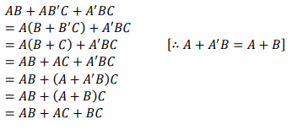

Algebraic Manipulation (contd.)
Prove the Boolean expression: 𝑨𝑩 + 𝑨𝑩′𝑪 + 𝑨 ′𝑩𝑪 = 𝑨𝑩 + 𝑨𝑪 + 𝑩C

Slide 15
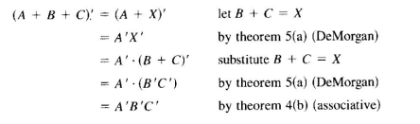
Complement of a function
The complement of a function 𝐹 is 𝐹 ′
Obtained from an interchange of 0’s for 1’s and 1’s for 0’s in the value of 𝐹
The complement of a function may be derived algebraically through De Morgan’s theorem

Slide 16
Logic Gates
An electronic device that produces a result based on one or more input values
Logic gate can be categories as follows:
Basic Gates
Universal Gates
Derived/Extended Gates

Slide 17
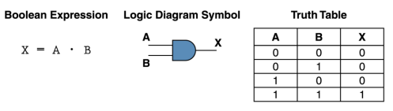
Basic Gates
AND GATE
AND gate accepts two input signals. If the two input values for an AND gate are both 1, the output is 1; otherwise, the output is 0

Slide 18
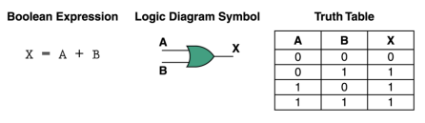
Basic Gates (contd.)
OR GATE
If the two input values are both 0, the output value is 0; otherwise, the output is 1

Slide 19
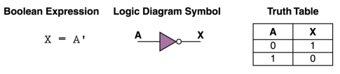
Basic Gates (contd.)
NOT Gate
A NOT gate accepts one input value and produces one output value.

Slide 20
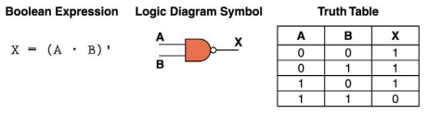
Universal Gates
NAND Gate
NAND gate is the combination of NOT gate and AND gate. If the two input values for an NAND gate are both 1, the output is 0; otherwise, the output is 1

Slide 21
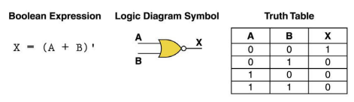
Universal Gates (contd.)
NOR GATE
NOR gate is the combination of NOT gate and OR gate. If the two input values for NOR gate are both 0, the output value is 1; otherwise, the output is 0.

Slide 22
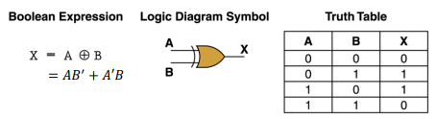
Derived/Extended Gates
Exclusive-OR gate (XOR)
An XOR gate produces 0 if its two inputs are the same, and a 1 otherwise.

Slide 23
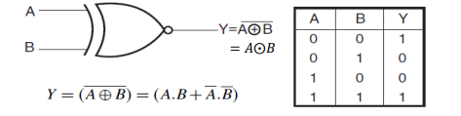
Derived/Extended Gates (contd.)
Exclusive-NOR gate (X-NOR)
X-NOR is the complement of X-OR. An X-NOR gate produces 1 if its two inputs are the same, and a 0 otherwise

Slide 24
Buffer Gate
The buffer gate returns the same output as same as that of input.
Input
Output
INPUT | OUTPUT
0 | 0
1 | 1

Slide 25
Universal Gates Realization
A universal gate is a gate which can implement any Boolean function without need to use any other gate type.
The NAND and NOR gates are universal gates.
NAND as a Universal Gate
To prove that any Boolean function can be implemented using only NAND gates, we will show that the AND, OR, and NOT operations can be performed using only these gates.

Slide 26
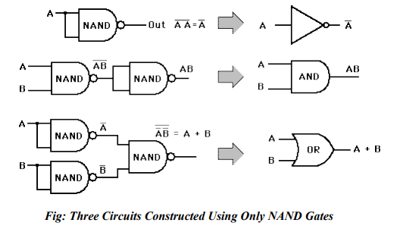
NAND as Universal Gate

Slide 27
Universal Gates Realization
NOR as a Universal Gate
To prove that any Boolean function can be implemented using only NOR gates, we will show that the AND, OR, and NOT operations can be performed using only these gates.

Slide 28
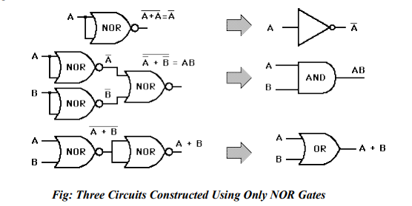
NOR as Universal Gate

Slide 29
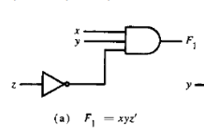
Implementation of Boolean Functions with Gates
𝐹1 = 𝑥𝑦𝑧 ′
𝐹2 = 𝑥 + 𝑦′𝑧
F3 = 𝑥′𝑦 ′𝑧 + 𝑥′𝑦𝑧 + 𝑥𝑦′

Slide 30
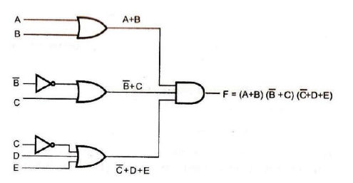
Implementation (contd.)
F = (A + B) (B' + C) (C' + D + E)

Slide 31
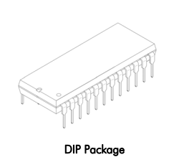
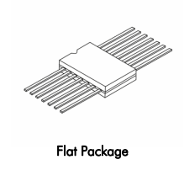
Integrated Circuit (IC)
Also called as a chip or microchip
Tiny electronic circuit used to perform a specific electronic function, such as amplification; it is usually combined with other components to form a more complex system
ICs come in two types of packages:
Flat package
DIP package (Dual Inline Package)

Slide 32
IC (contd.)
The DIP is most widely used because of the low price and easy installation on circuit boards
Most ICs have standard size and the number of pins range from 8 to 64
The size of IC package is very small but offer a wide variety of advantages
Low cost/economical
Reduce power consumption
High reliability against failure. So, digital systems need less repairs
High operating speed and suitable for high speed operation
Reduce the use of external wiring connections as connection is internal to the package

Slide 33
IC (contd.)
ICs can be categorized into two types:
Analog or Linear ICs
Digital or logic ICs
Linear IC
They produce continuous output depending on the input signal.
Output is a linear function of the input signal
Op-amp (operational amplifier) is one of the types of linear ICs which are used in amplifiers, timers and counters, oscillators etc.

Slide 34
IC (contd.)
Logical IC
Unlike Linear ICs, Logical ICs never give a continuous output signal.
It operates only during defined states
Digital ICs are used mostly in microprocessor and various memory applications
Logic gates are the building blocks of Digital ICs which operate either at 0 or 1.

Slide 35
IC (contd.)
Often classified by the number of transistors and other electronic components they contain such as:
SSI (small-scale integration): Up to 100 electronic components per chip
MSI (medium-scale integration): From 100 to 3,000 electronic components per chip
LSI (large-scale integration): From 3,000 to 100,000 electronic components per chip
VLSI (very large-scale integration): From 100,000 to 1,000,000 electronic components per chip
ULSI (ultra large-scale integration): More than 1 million electronic components per chip.

Slide 36
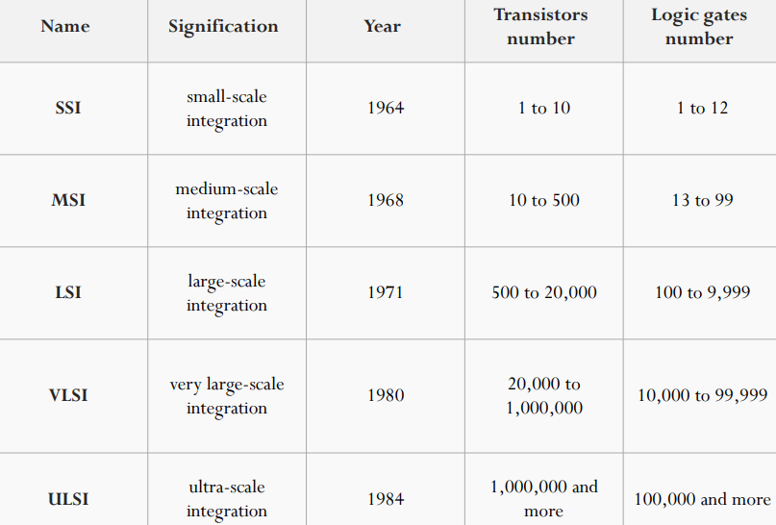
Scale of Integration

Slide 37
DIP (Dual in-line packages)
DIP is a type of semiconductor component packaging
DIPs can be installed either in sockets or permanently soldered into holes extending into the surface of the printed circuit board
DIP is relatively broadly defined as any rectangular package with two uniformly spaced parallel rows of pins pointing downward, whether it contains an IC chip or some other device(s), and whether the pins emerge from the sides of the package and bend downwards
A DIP is usually referred to as a DIPn, where n is the total number of pins
For example, a microcircuit package with two rows of seven vertical leads would be a DIP14. The photograph below shows three DIP14 ICs.

Slide 38
DIP (contd.)
Several DIP variants for ICs exist, mostly distinguished by packaging material:
Ceramic Dual In-line Package (CERDIP or CDIP)
Plastic Dual In-line Package (PDIP)
Shrink Plastic Dual In-line Package (SPDIP) -A denser version of the PDIP with a 0.07 in. (1.778 mm) lead pitch.
Skinny Dual In-line Package (SDIP) – Sometimes used to refer to a 0.3 in. wide DIP, normally when clarification is needed e.g. for a 24 or 28 pin DIP.

Slide 39
Single In-line Memory Module (SIMM)
A circuit board that holds six to nine memory chips per board
The ninth chip usually an error checking chip (parity/non parity) and were commonly used with Intel Pentium or Pentium compatible motherboards.
SIMMs are rarely used today and have been widely replaced by DIMMs
SIMMs are available in two flavors: 30 pin and 72 pin
30-pin SIMMs are the older standard, and were popular on third and fourth generation motherboards
72-pin SIMMs are used on fourth, fifth and sixth generation PCs.

Slide 40
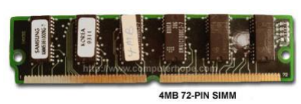
SIMM (contd.)

Slide 41
IC Digital Logic Families
TTL (Transistor-Transistor Logic)
ECL (Emitter-Coupled Logic)
MOS (Metal-Oxide Semiconductor)
CMOS (Complementary Metal-Oxide Semiconductor)
IIL (Integrated Injection Logic)

Slide 42
IC Digital Logic Families (contd.)
TTL (Transistor-Transistor Logic)
Evolved from a previous technology that used diodes and transistors for the basic NAND gate
This technology was called DTL for diode-transistor logic.
Later the diodes were replaced by transistors to improve the circuit operation and the name of the logic family was changed to TTL
ECL (Emitter-Coupled Logic)
Provides the highest speed among the integrated digital logic families
Used in systems such as supercomputers and signal processors, where high speed is essential
The transistors in ECL gates operate in a non-saturated state, a condition that allows the achievement of propagation delays of 1 to 2 nanoseconds

Slide 43
IC Digital Logic Families (contd.)
MOS (Metal-Oxide Semiconductor)
Unipolar transistor that depends upon the flow of only one type of carrier, which may be electrons (n-channel) or holes (p-channel)
p-channel MOS is referred to as PMOS and an n-channel as NMOS
NMOS is commonly used
CMOS (Complementary Metal-Oxide Semiconductor)
Uses one PMOS and one NMOS transistor connected in a complementary fashion in all circuits
The most important advantages of MOS over bipolar transistors are the high packing density of circuits, a simpler processing technique during fabrication, and a more economical operation because of the low power consumption

Slide 44
IC Digital Logic Families (contd.)
IIL (Integrated Injection Logic)
also known as I²L or I2L
built with multiple collector bipolar junction transistors (BJT)
I2L has high noise immunity because it operates by current instead of voltage
it had speed comparable to TTL, yet was almost as low power as CMOS, making it ideal for use in VLSI (and larger) integrated circuits
Sometimes also known as Merged Transistor Logic

Slide 45

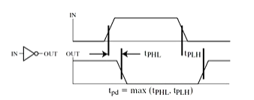
Special Characteristics of IC
Fan-in - the number of inputs a gate can handle
Fan-out - the number of standard loads that the output of a gate can drive without impairing its normal operation
Power dissipation - the supplied power required to operate the gate
Propagation delay - the average transition delay time for a signal to propagate from input to output when the binary signals change in value.
Noise margin - the maximum noise voltage added to the input signal of a digital circuit that does not cause an undesirable change in the circuit output

Slide 46
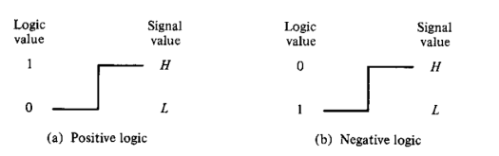
Positive and Negative Logic
The binary signal at the inputs and outputs of any gate has one of two values, except during transition. One signal value represents logic-1 and the other logic-0. So there is a possibility of two different assignments of signal level to logic value
Positive logic: H = 1; L = 0
Negative Logic: H = 0; L = 1

Slide 47
Positive and Negative Logic (contd.)
x | y | F
L | L | L
L | H | L
H | L | L
H | H | H
x
Digital Gate
F
y

